Slide 1
Housing Dataset Analysis
NAME: GOWTHAM S
COURSE: DA&DS
BATCH: FEB 2025
DATE: 09/06/2025

Slide 2
Dataset Overview
The dataset contains information on residential properties for sale
Includes 18 Columns and 4600 Rows covering structural, financial, and geographic aspects
Target variable : price for each property
Key features : bedrooms, bathrooms, sqft living, sqft lot, floors, sqft basement, sqft above
Location-related data : street, city, state zip, country

Slide 3
Data Cleaning & Preprocessing
Handled Missing Values
Removed Duplicates
Replaced Null values
Datatype Changed

Slide 4
Data Cleaning & Preprocessing
Encoded categorical features:
Transformed view and condition.
View : 0: "No view", 1: "Poor view", 2: "Average view", 3: "Good view", 4: "Excellent view“
Condition : 1: "Poor", 2: "Fair", 3: "Average", 4: "Good", 5: "Excellent“
Converted date formats:
Extracted year, month from date column for time based analysis.

Slide 5
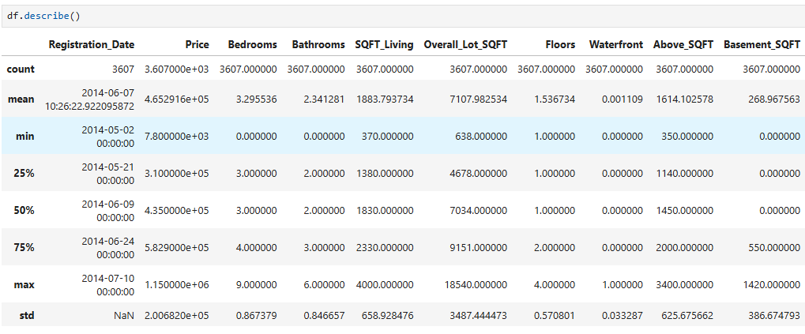
Statistical Analysis

Slide 6

Hypothesis Testing, T-Test
This performs a two-sample t-test to compare the mean prices of the two groups (single vs multi floor houses).
Null Hypothesis (H₀):There is no difference in the mean price.
Alternative Hypothesis (H₁):The mean prices are different between the two groups.
Result:
The p-value < 0.05, so we reject the null hypothesis.
There is a statistically significant difference in average prices.

Slide 7
Exploratory Data Analysis (EDA)
Univariate: distribution of price, size, and condition.
Bivariate: price vs sqft, bedrooms vs bathrooms.
Multivariate: interaction of location, view, and renovation.

Slide 8
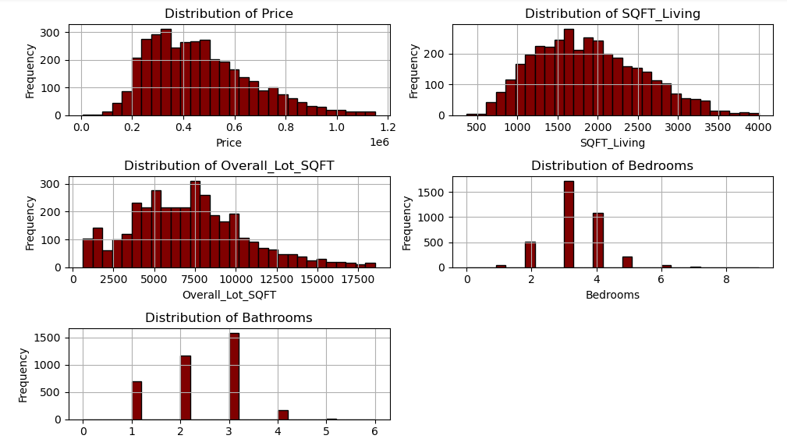
Data Visualization, Univariate Analysis

Slide 9
Insights of Univariate analysis
Distribution of Price:
Most of the homes are priced between 200000 to 600000 with expensive homes (right-skewed).
Living SQFT:
Most of the homes have living area around 1000–2500 sqft. Some very large houses (outliers).
Overall SQFT:
Lot sizes vary slightly; most are small, but a few are very large.
Bedrooms:
Majority of homes have 3 or 4 bedrooms. 6 bedrooms are the least one.
Bathrooms:
Most of the homes have 1–3 bathrooms. More than 4 is rare.

Slide 10
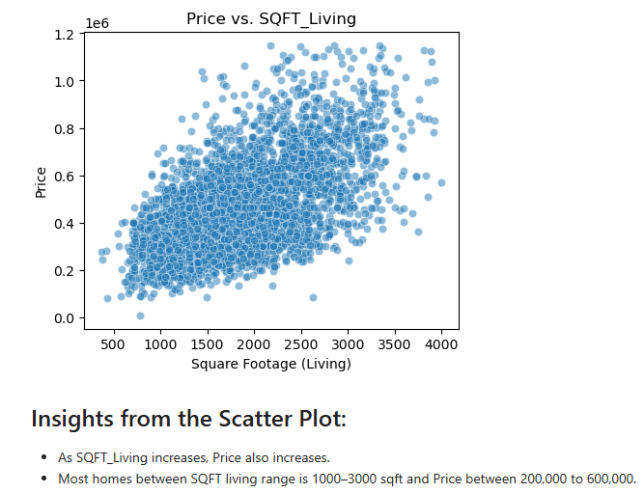
Bivariate Analysis, Scatterplot
SQFT_Living increases, Price also increases
Most homes between SQFT living range is 1000–3000 sqft
Price between 200,000 to 600,000.

Slide 11
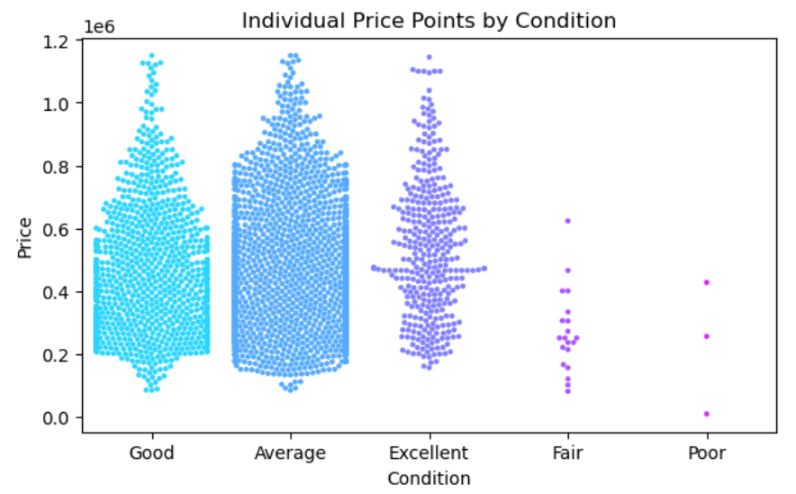
Bivariate Analysis, Swarmplot
Most houses are in either Good or Average condition.
Excellent Condition houses are less but high in price.
Fair and Poor Conditions are very few houses into these categories.

Slide 12
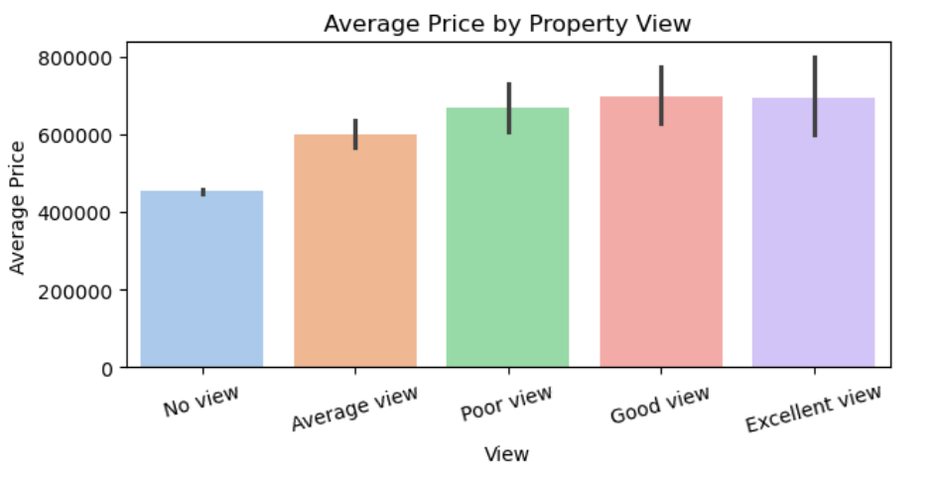
Bivariate Analysis, Barplot
Houses with Excellent view have the highest average price.
Analyst for Real estaters : If you are in real estate investing in properties with good or excellent views so this can possible for higher incomes.

Slide 13
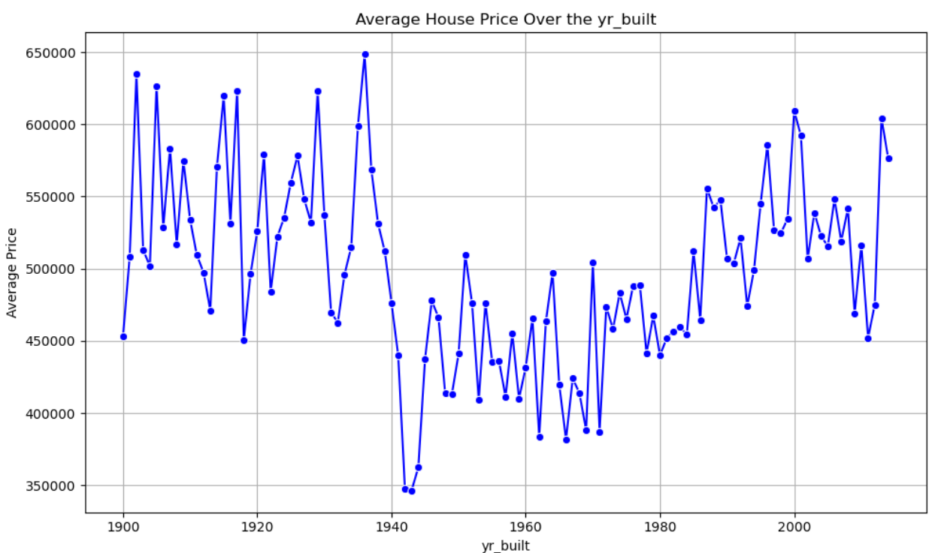
Bivariate Analysis, lineplot
From 1980 onwards average prices generally increase which may reflect the Economic growth and demand for newer houses.
Houses built after 2000 to have higher average prices it suggests a better amenities, construction costs.

Slide 14
Findings & Insights
Sqft living, view, and location are strongest price drivers.
Renovated and waterfront homes command premium prices.
Square footage ,sqft living, view quality, and overall grade are the most influential features on housing prices.
Waterfront properties and those with renovations are priced significantly higher than similar homes without these features.
Excessively large lots or more than 5 bedrooms show diminishing returns in price impact.

Slide 15
Recommendations
Invest in renovations for older homes to increase property value and appeal.
Focus on high-view or waterfront properties for premium pricing potential.
Use sqft based pricing strategies combined with condition and location.
For sellers: list properties in peak months (May, June) for better visibility and pricing.

Slide 16
Thank You

